Slide 1
Photography

Slide 2
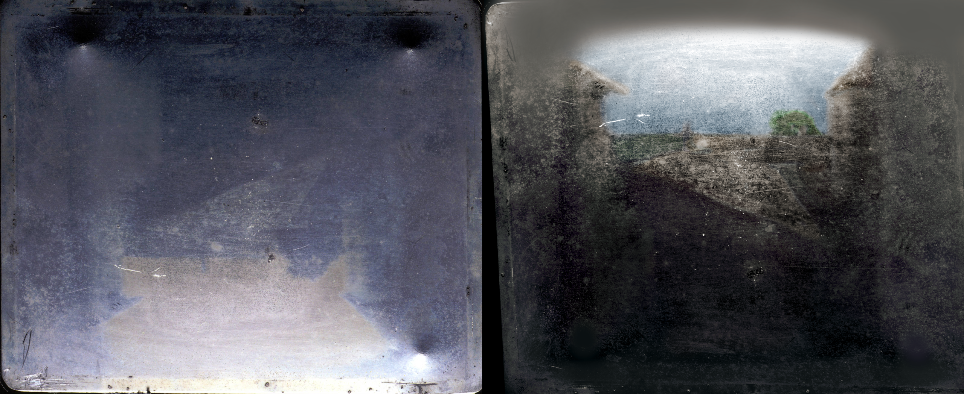
The earliest durable, surviving photograph was taken in 1826 or 1827 by Niépce.
Jonnychiwa, 2020, CC BY-SA 4.0

Slide 3
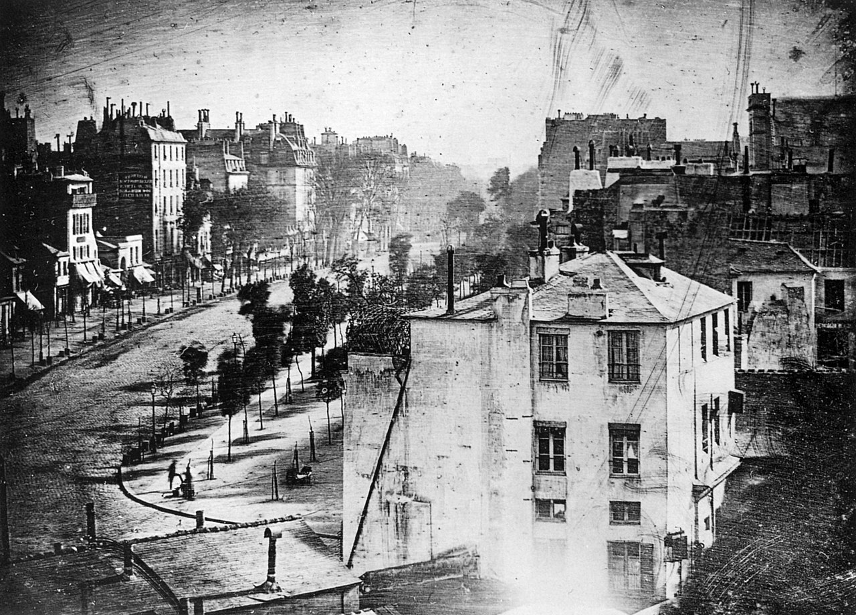
The earliest photograph to include people was taken in 1838 by Daguerre
Daguerre, 1838, Public Domain

Slide 4
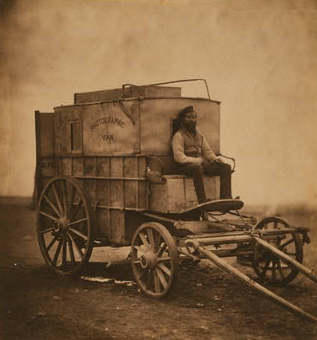
Early photography required photographers to bring a lot of equipment and chemicals
Fenton, 1855, Public Domain

Slide 5
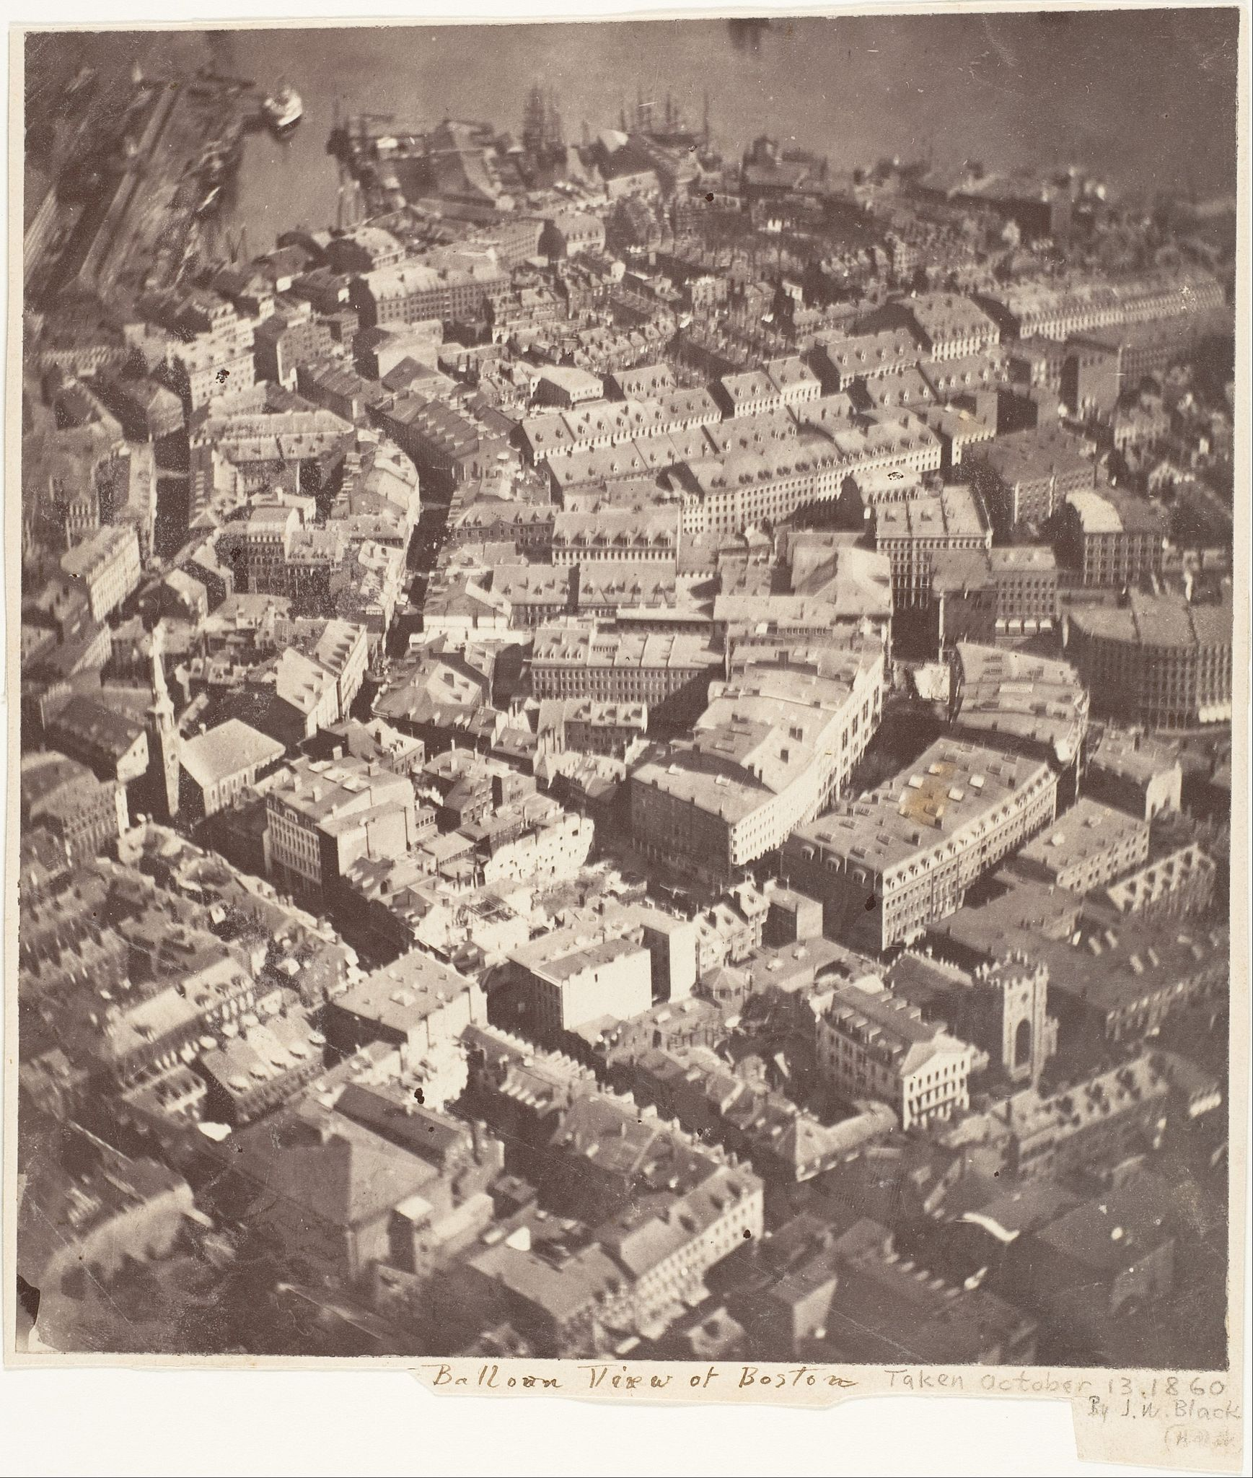
The first known aerial photograph was taken of Boston in 1860
Black, 1860, Public Domain

Slide 6
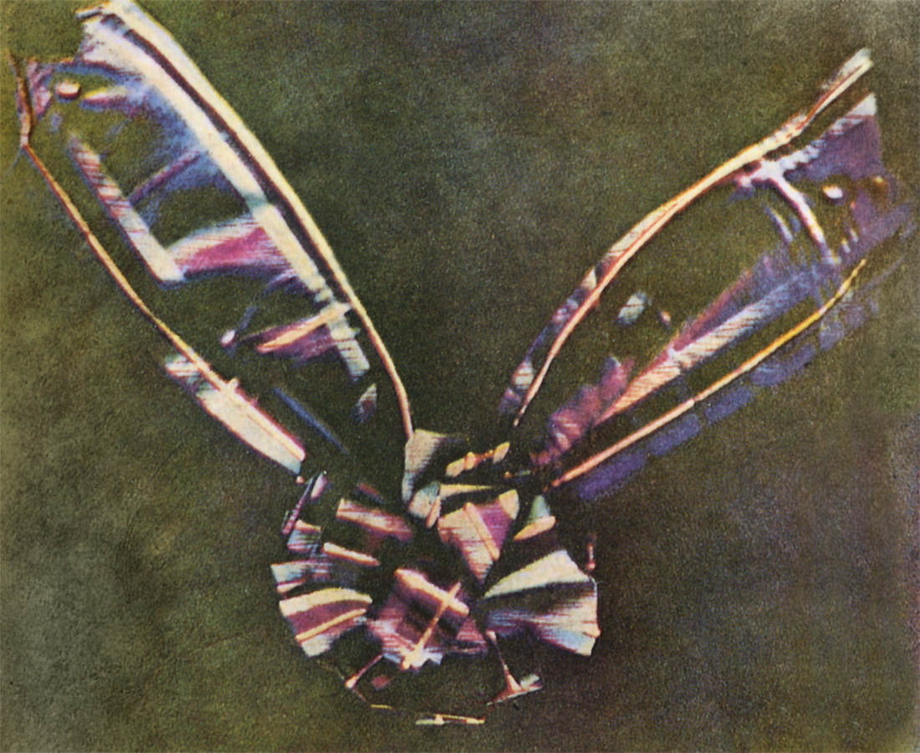
The first known durable color photograph was taken by Thomas Sutton in 1861.
Maxwell, 1861, Public Domain

Slide 7
Photography and manipulation

Slide 8
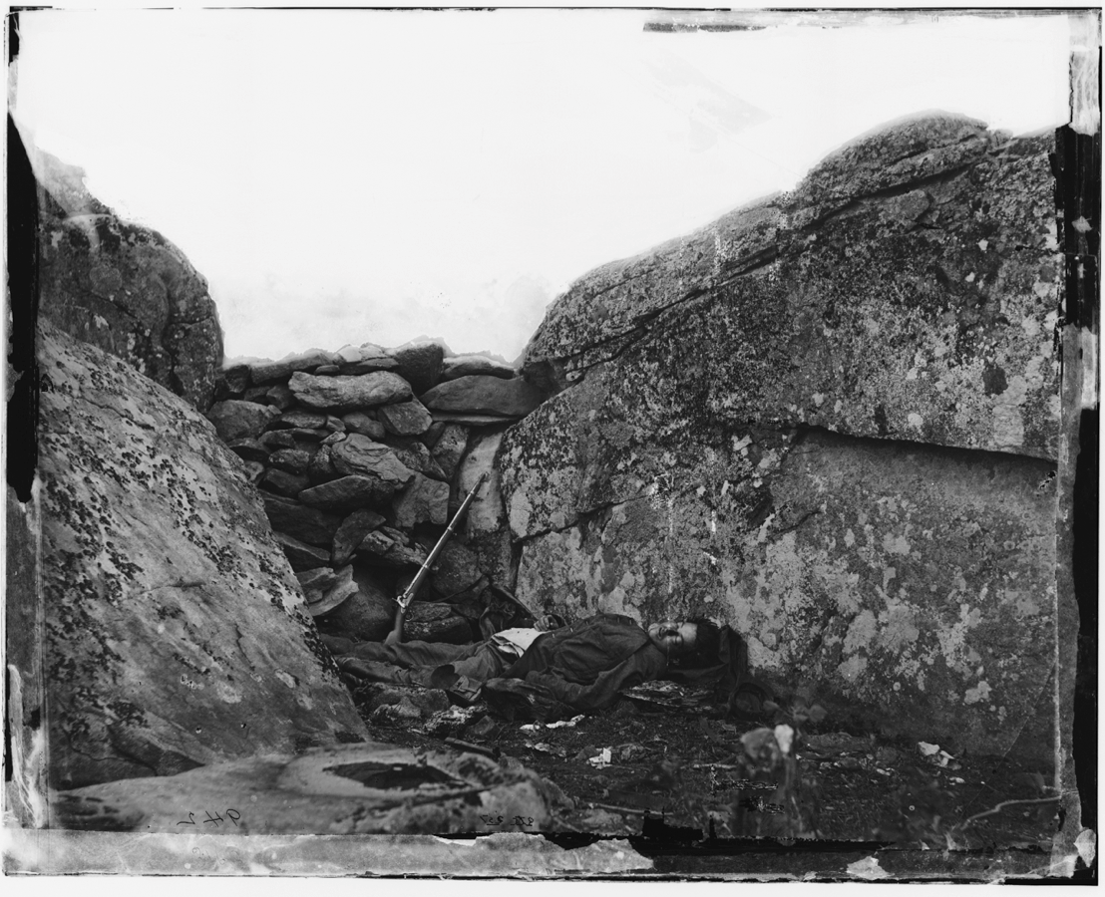
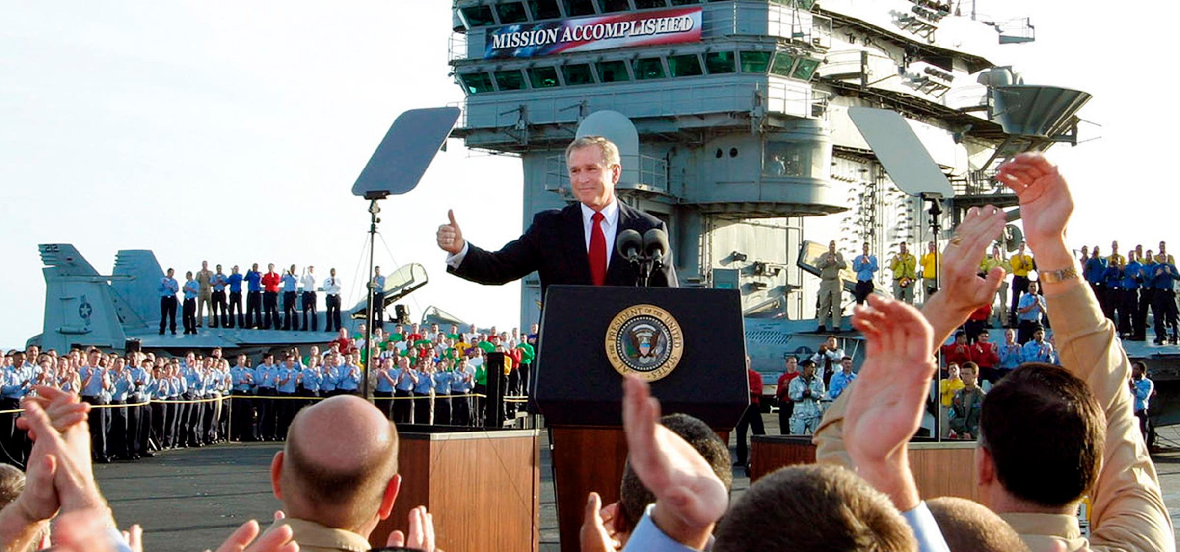
Photos can be manipulated through staging the scene.
Gardner, 1863, Public Domain
Applewhite, 2003, Fair Use

Slide 9
Photos can be manipulated through cropping.

Slide 10
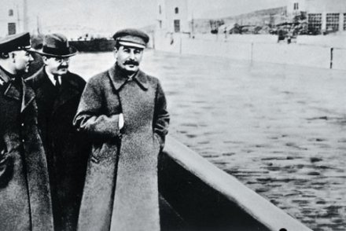
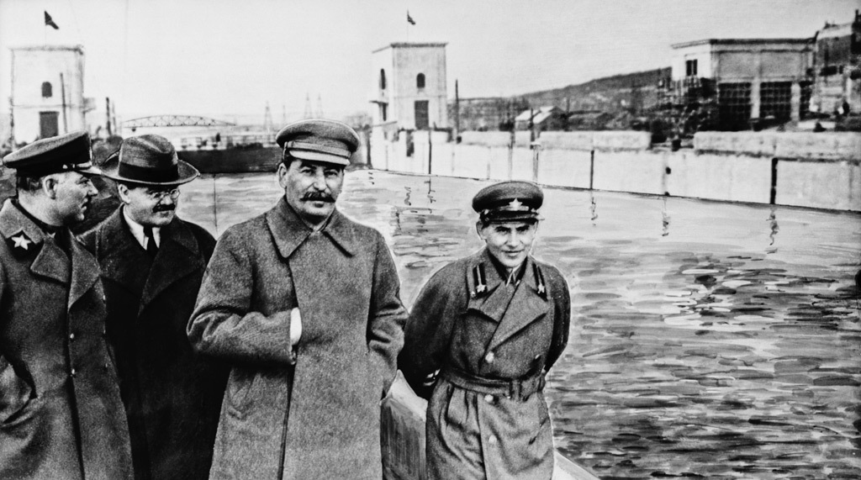
Photos can be manipulated through alteration.
Unknown Photographer, circa 1930, Public Domain

Slide 11
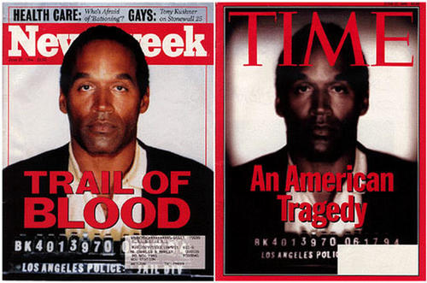
Photos can be manipulated through alteration.
Los Angeles Police Jail Division, 1994, Public Domain

Slide 12
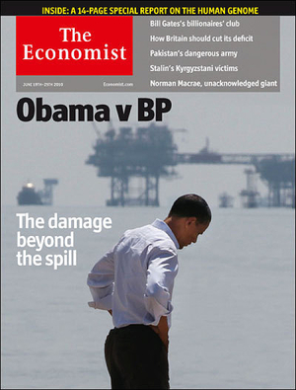
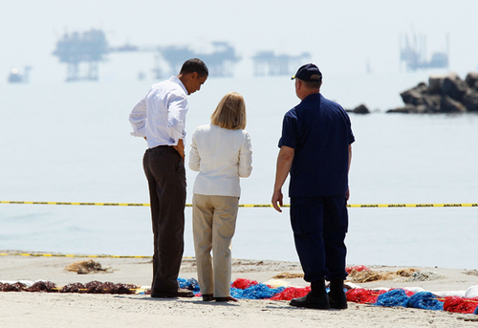
Photos can be manipulated through cropping and manipulation.
Downing, 2010, Fair Use

Slide 13
Photos are manipulated through misrepresentation.

Slide 14
Applewhite, J. S. (2003, May 1). Mission accomplished [Photograph]. http://www.alteredimagesbdc.org/applewhite/
Black, J. W. (1860, October 13). Boston, as the eagle and the wild goose see it. [Photograph].
Daguerre, L. (1838). Boulevard du temple [Photograph]. https://en.wikipedia.org/wiki/File:Boulevard_du_Temple_by_Daguerre.jpg
Downing, L. (2010, June 19). Obama vs. BP [Photograph]. http://www.alteredimagesbdc.org/the-economist/
Fenton, R. (1855). The artist’s van [Photograph]. http://loc.gov/pictures/resource/cph.3g09240/
Gardner, A. (1863, July). Gettysburg, Pa. Dead Confederate soldier in Devil’s Den [Photograph]. https://www.loc.gov/resource/cwpb.04337/
Jonnychiwa (2020, April 3). View from the window at Le Gras, colorized [Digitally Retouched Photograph].
Los Angeles Police Jail Division (1994, June 27). OJ Simpson Mugshot [Photograph]. http://www.alteredimagesbdc.org/oj-simpson/
Maxwell, J. C. (1861). Tartan Ribbon [Photograph]. https://commons.wikimedia.org/wiki/File:Tartan_Ribbon.jpg
Unknown Photographer (circa 1930). Commissar Yezhov with Stalin [Photograph]. http://www.alteredimagesbdc.org/stalin/
References

